Slide 1


IMDB Movies
IMDB MOVIES PROJECT IN SQL
Team Member – Sejal S Golam Shamil A Ghodake
Bhavana V Shinde
Project Team ID : PTID-CDA-DEC-24-274
Project ID : PRSQL-01

Slide 2
IMDB Movies

Slide 3

STEPS IN THIS PROJECT
Business Requirements / Understand Dataset
2. Load Data into MYSQL Workbench
3. Solve Tasks
4. Export & share project

Slide 4
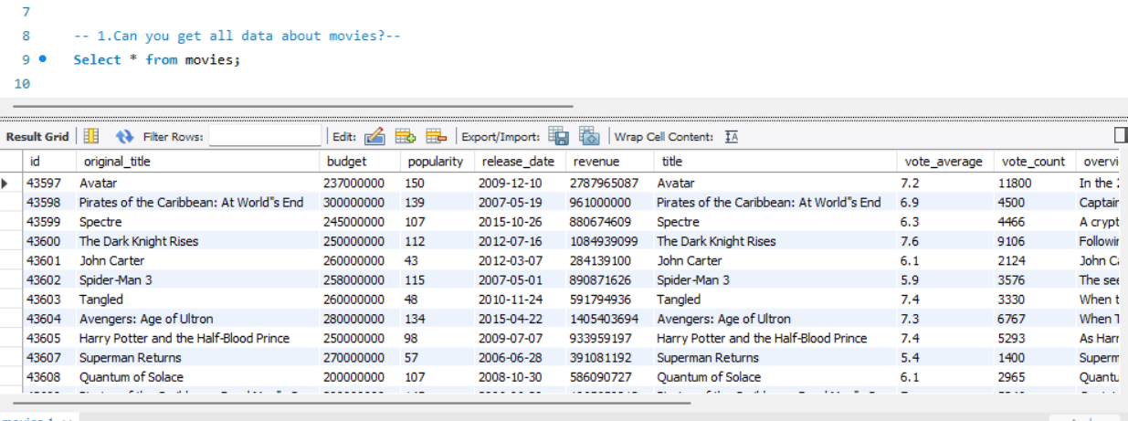
Q&A
1.Can you get all data about movies?

Slide 5
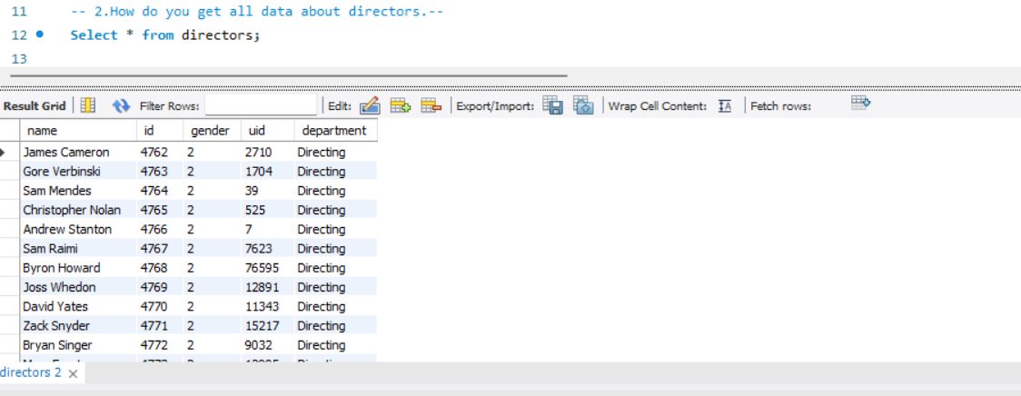
Q&A
2.How do you get all data about directors?

Slide 6
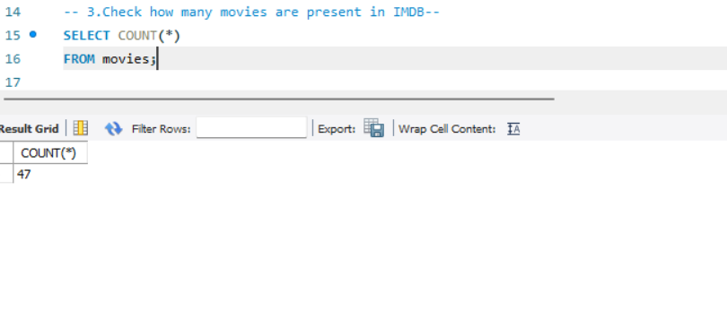
Q&A
3. Check how many movies are present in IMDB.

Slide 7
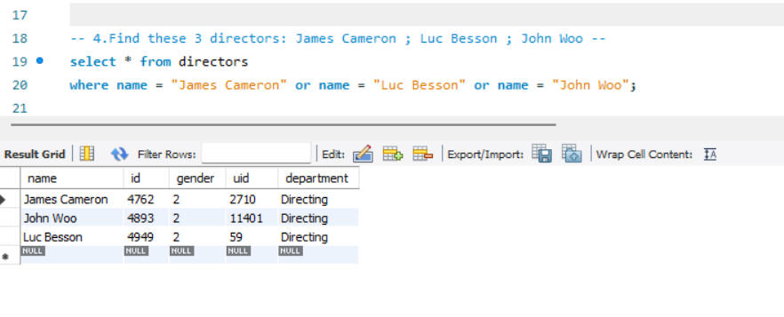
Q&A
4. Find these 3 directors: James Cameron ; Luc Besson ; John Woo

Slide 8
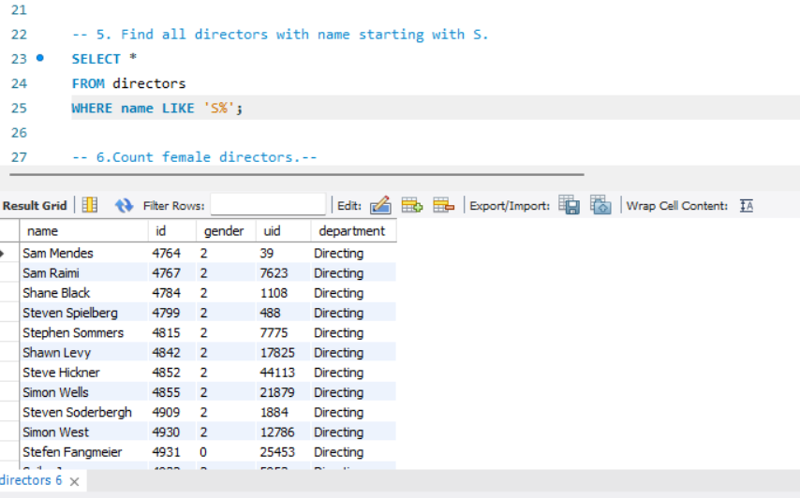
Q&A
5. Find all directors with name starting with S.

Slide 9
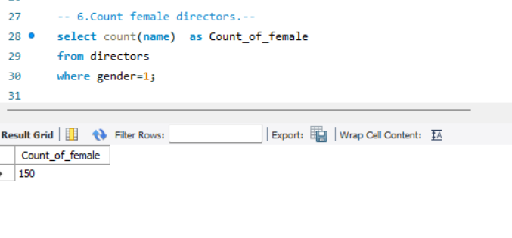
Q&A
6. Count female directors.

Slide 10
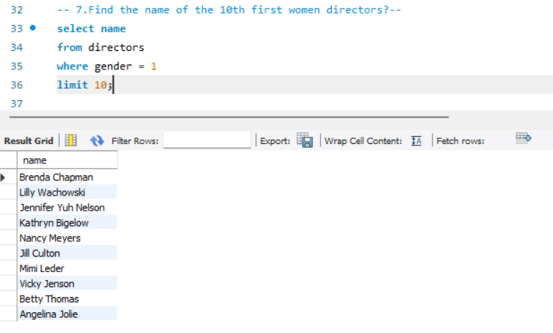
Q&A
7. Find the name of the 10th first women directors?

Slide 11
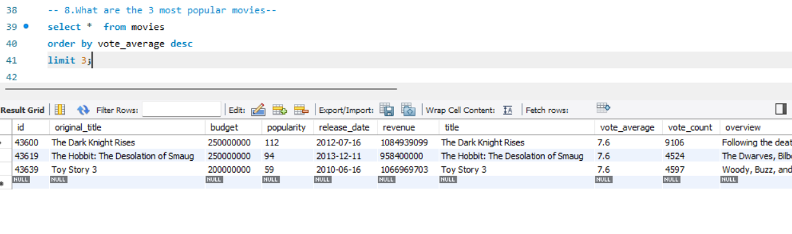
Q&A
8. What are the 3 most popular movies?

Slide 12
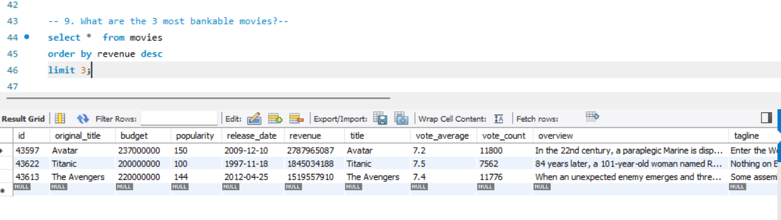
Q&A
9. What are the 3 most bankable movies?

Slide 13
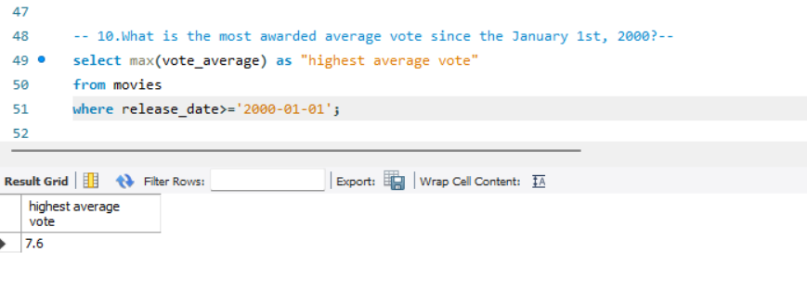
Q&A
10. What is the most awarded average vote since the January 1st, 2000?

Slide 14
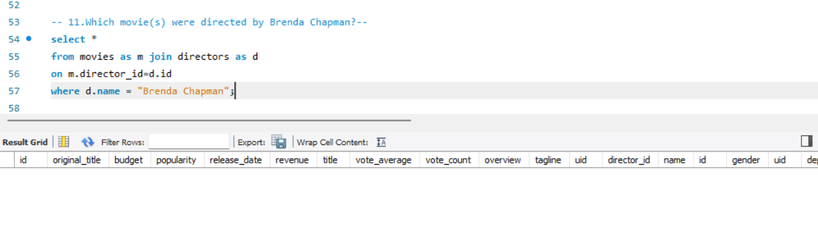
Q&A
11. Which movie(s) were directed by Brenda Chapman?

Slide 15
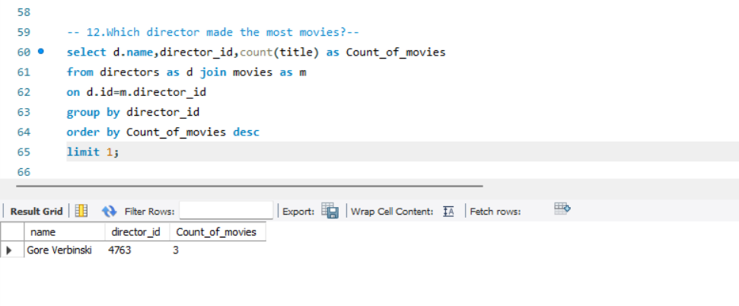
Q&A
12. Which director made the most movies?

Slide 16
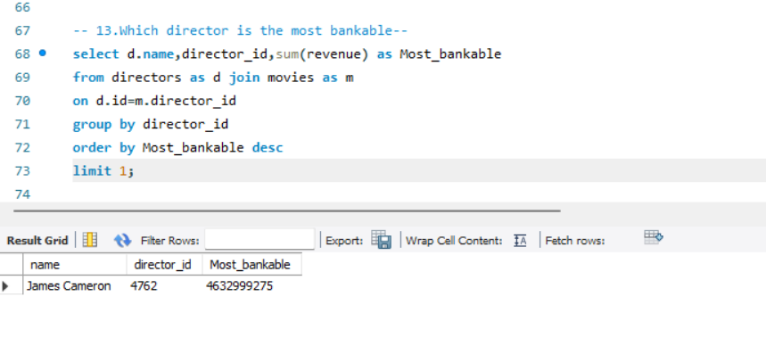
Q&A
13. Which director is the most bankable?

Slide 17
THANK YOU!!

